Slide 1


THE ADA PROJECT
TEAM DELTA - DATA TRACK

Slide 2
INSIGHTS FROM SQL ANALYSIS OF A MENTAL HEALTH SURVEY
Collaborators:
Eliel Godsent
Sophia Abubakar
Team Members:
Ifeanyi Michael
Akeem Abiodun
Ojukwu Sheila
Favour Joseph

Slide 3

Objective
To communicate the insights gained from the analysis of the responses from the survey on mental health .

Slide 4
Introduction
This project is basically centered on Mental Health Analysis. The database used for this work is from Open Source Mental Illness(OSMI) surveys of 2014, 2016, 2017, 2018, and 2019.
Each of the surveys generally measures attitudes toward mental health and frequency of mental health disorders and all of the surveys were used for our analysis.
Analysis were carried out to get deeper insights into the database using Structured Query Language (SQL) and here we present five insights we gained .

Slide 5
Insights From The Dataset
To gain an insight into the database, several queries were run using the Structured Query Language (SQL) and the outputs are displayed in tables.
The survey consists of 4218 participants from several countries with the United States of America ranking the highest in responses.
Also, average age of participants can be seen below:
34

Slide 6
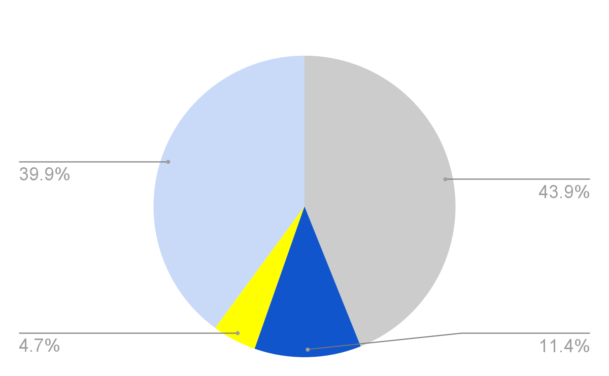
Insight 1 - Americans dominated the survey.
Average age: 34

Slide 7
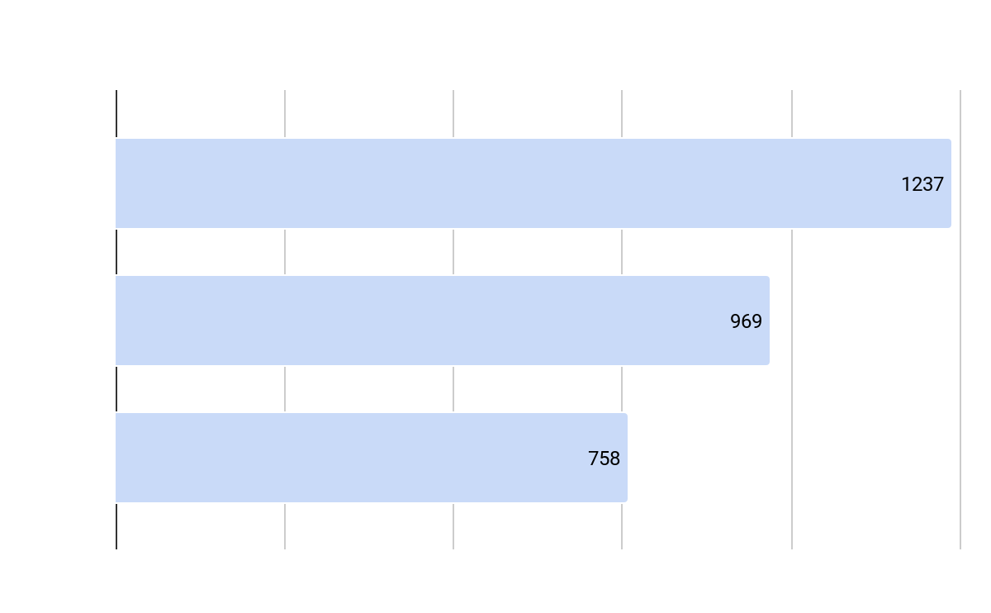
Insight 2 - Most people are aware of their mental health status
In addition, mood disorder (Depression, Bipolar disorder, Anxiety disorder etc) are the most common mental conditions people believe that they may have.

Slide 8

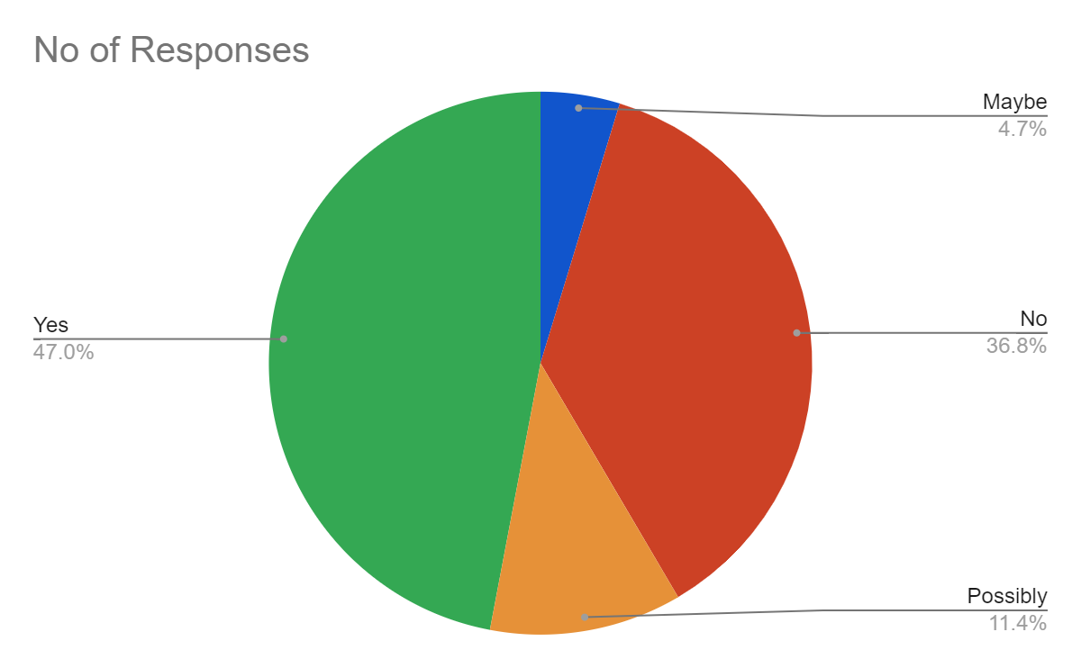
Insight 3 - Most people have been diagnosed of mental health disorder.
It is also of high importance to note that there are more participants in the survey who have been diagnosed of mental health disorder than those who have not and those who are negative. In total, more people know their status than those who do not.

Slide 9
Insight 4 - Employers don’t care about mental health.
Of the total 2693 respondents to this question , only 693 feel their employers take mental health as seriously as physical health, 1069 do not know while 931 feel they do not.
most employers do not discuss mental health as part of the employee wellness program, as only 229 do out of a total 1260 responses , while 843 do not.
Furthermore, most responders believe their work colleagues would have a negative perception of them if they know of their mental condition. We can infer that the attitude toward mental health and persons with mental health disorder in the workplace is poor.

Slide 10
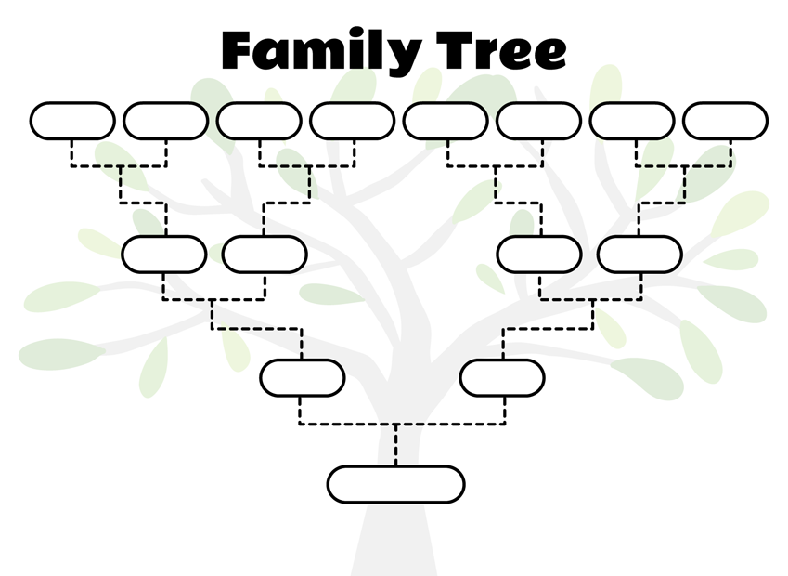
Insight 5 - Mental illness is hereditary.
It was found that persons with a family history of mental illness are at higher risk of mental illness as most people with mental health challenges seem to also have persons with similar illness in their family history

Slide 11
Conclusion
While data shows a general high rate of awareness of individuals toward their mental health, and a high rate of mental health diagnosis, attitude towards people with mental health disorder is poor.
Also, people with mental disorder in their family History have higher chance of mental health disorder.

